Slide 1
CSE 424 Project Presentation
Obstacle Pattern Recognition From Vehicle Perspective
Section: 01
Group Number: 23
Group Members:
Md. Imamul Mursalin Sujoy (20301120)
Md. Asif Rahman (20301122)
Jannatul Ferdoush (20301291)
Utsha Sen Dhruba (20301338)

Slide 2
Goals
Object detection in a way which is more efficient and reliable for autonomous vehicle or mobile robots.
The detection of objects are -
Pedestrians
Cars
Cyclists
Animals
Electric pole
Object detection procedures -
Localization
Classification

Slide 3
Literature Review
Paper: You Only Look Once : Unfield, Real-Time Object Detection
The paper presents a unifield , real-time object detection system that achieves fast processing speeds and high generalization
YOLO enables end-to-end training and achieves real-time speeds, processing up to 155 frames per second.
It generalize top detection methods like DPM and R-CNN when tested on different domains, such as artwork.
The model have difficulties localizing small objects and can produce localization errors.

Slide 4
Literature Review
Paper: Object Detection Using Convolutional Neural Networks
To implement the object detection using CNN, TensorFlow Object detection API was used which is an open source framework for object detection models.
Two state of the art models are compared for object detection
SSD with MobileNetV1 has high speed detection but low accuracy
Faster-RCNN with InceptionV2 has low speed but more accurate detection

Slide 5
Literature Review
Paper: Faster R-CNN: an Approach to Real-Time Object Detection
This model merges RPN and Fast R-CNN thus it offers improved speed and accuracy
Four classes, allocating 80% for training and 20% for testing
The paper have showed good potential on identifying traffic signal on real time using cheap dashboard camera.
The model does not work well when the images are not stable enough, when there are bumps on the road the accuracy decreases.

Slide 6
Literature Review
Paper: Object Detection and Recognition using one stage improved YOLOv3
The primary concern for using this detector is speed more than the accuracy
The running speed is significantly increased which is approximately 442% faster
This paper does not extend object localization and recognition from static pictures to a video containing the dynamic sequence of images
Provided the comparisons of different models

Slide 7
Dataset Description
nuScenes dataset
Developed by the nuTonomy team at MIT
3D annotations of 23 classes
1600 x 900 resulations
More than 50,000 images
Data collected from Boston and Singapore
Hello

Slide 8
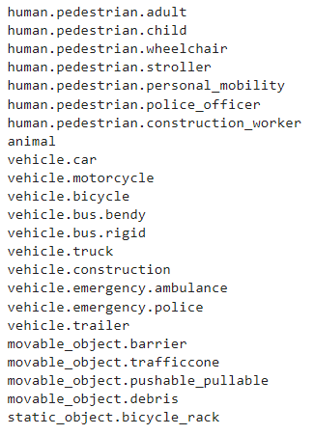
Classes of nuScenes Dataset

Slide 9
Data Preprocessing
Extracting 2D bounding boxes from corresponding 3D bounding boxes
Splitting the dataset into 70% for training, 15% for validation and 15% for testing
Default confidence score threshold is 25%
Resolution and subdivision of the base model are 416 x 416 and 8 respectively

Slide 10
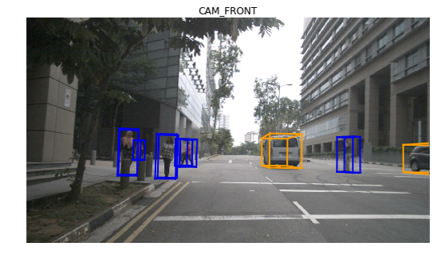
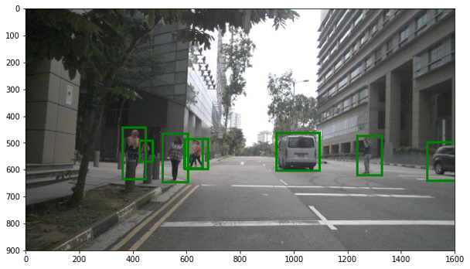
3D to 2D Bounding Boxes

Slide 11
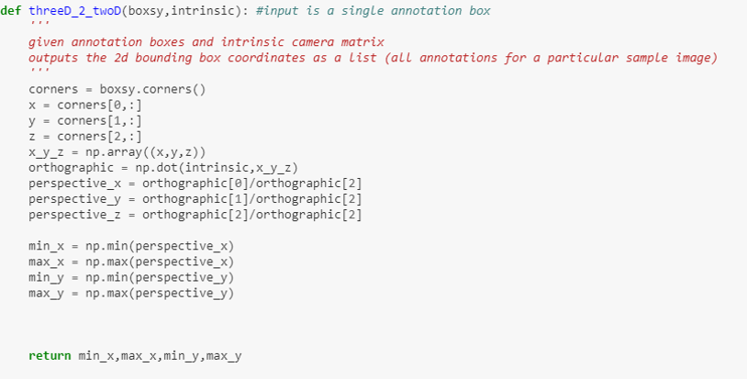
3D to 2D Bounding Boxes

Slide 12
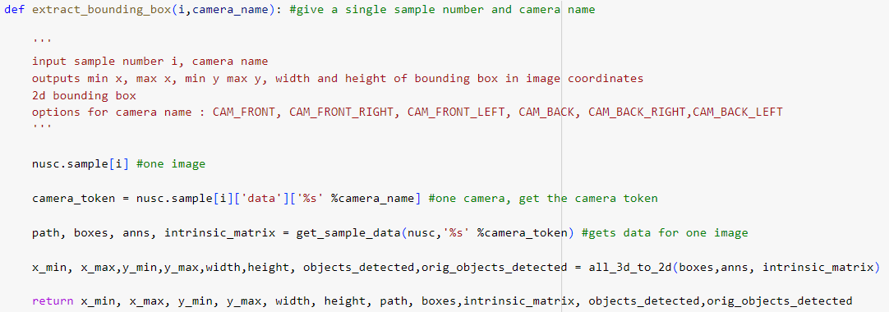
Extracting Bounding Boxes

Slide 13
Dataset Description
Roboflow dataset
Annotations of 10 classes
Various resulations
More than 9,000 images
Hello

Slide 14
Data Preprocessing
Adam optimizer
Blur(p=0.01, blur_limit=(3, 7))
MedianBlur(p=0.01, blur_limit=(3, 7))
ToGray(p=0.01)
CLAHE(p=0.01, clip_limit=(1, 4.0)
Splitting the dataset into 85% for training, 10% for validation and 5% for testing

Slide 15
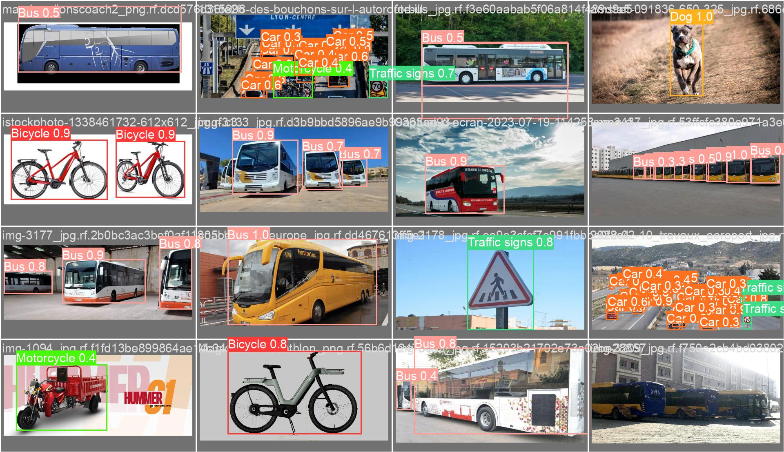
Classes of Roboflow dataset

Slide 16
Model for Project
YOLOv8
Faster compared to other versions
Less computational requirements
Real-time implementation
Still developing
Hello

Slide 17
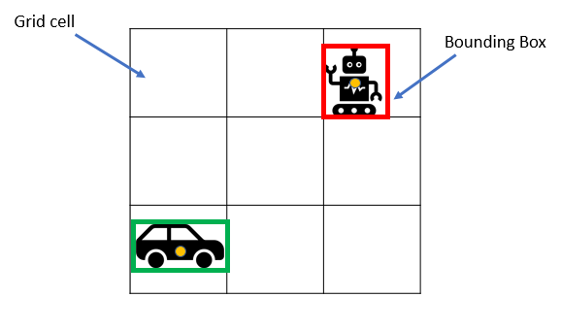
Method of YOLO

Slide 18
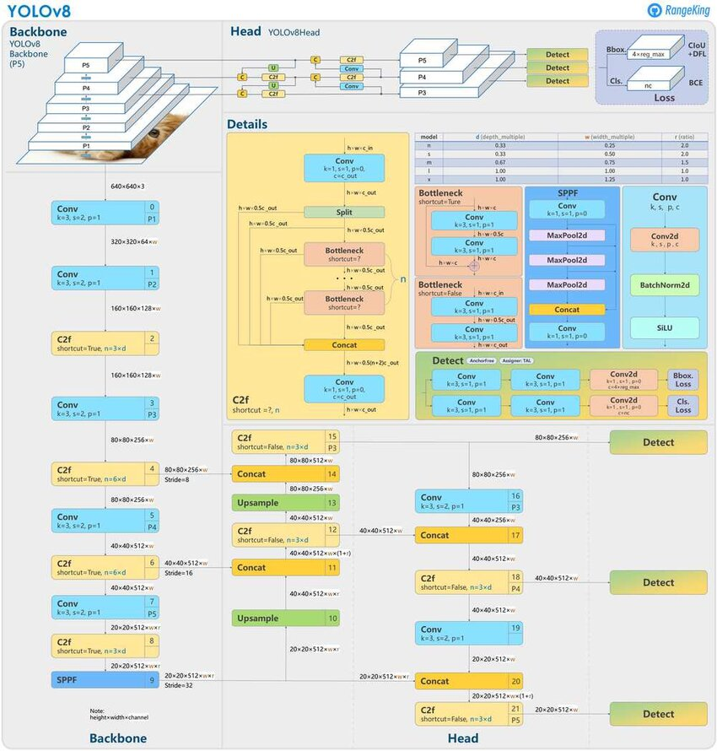
Structure
of YOLOv8

Slide 19
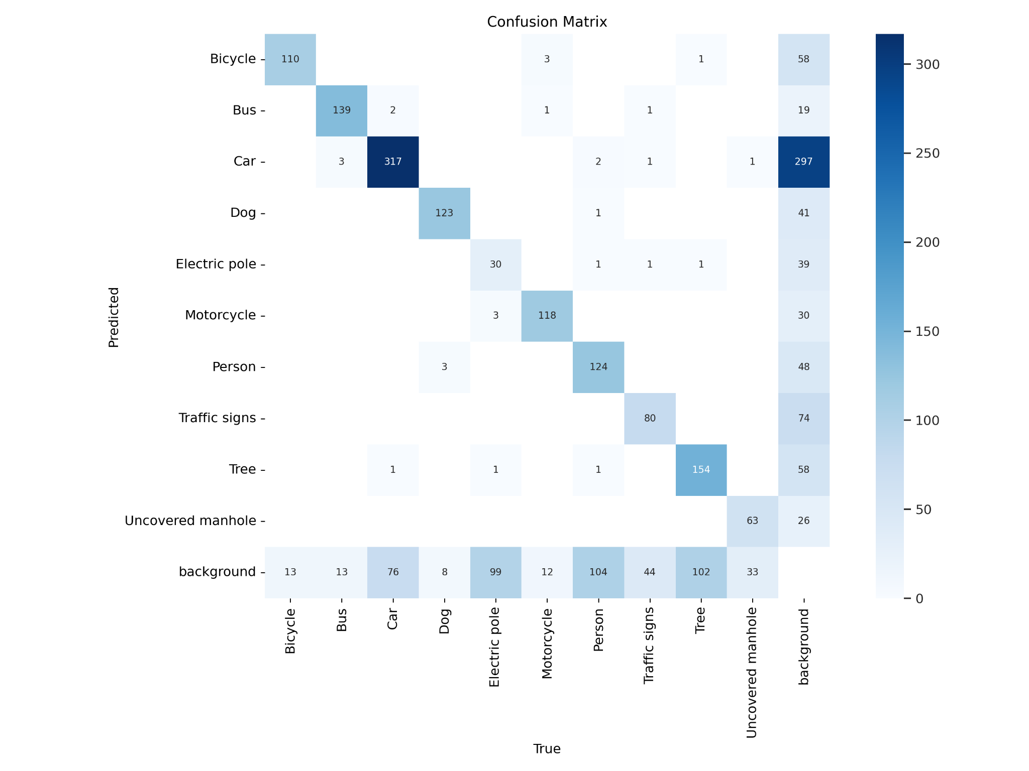
Confusion matrix

Slide 20
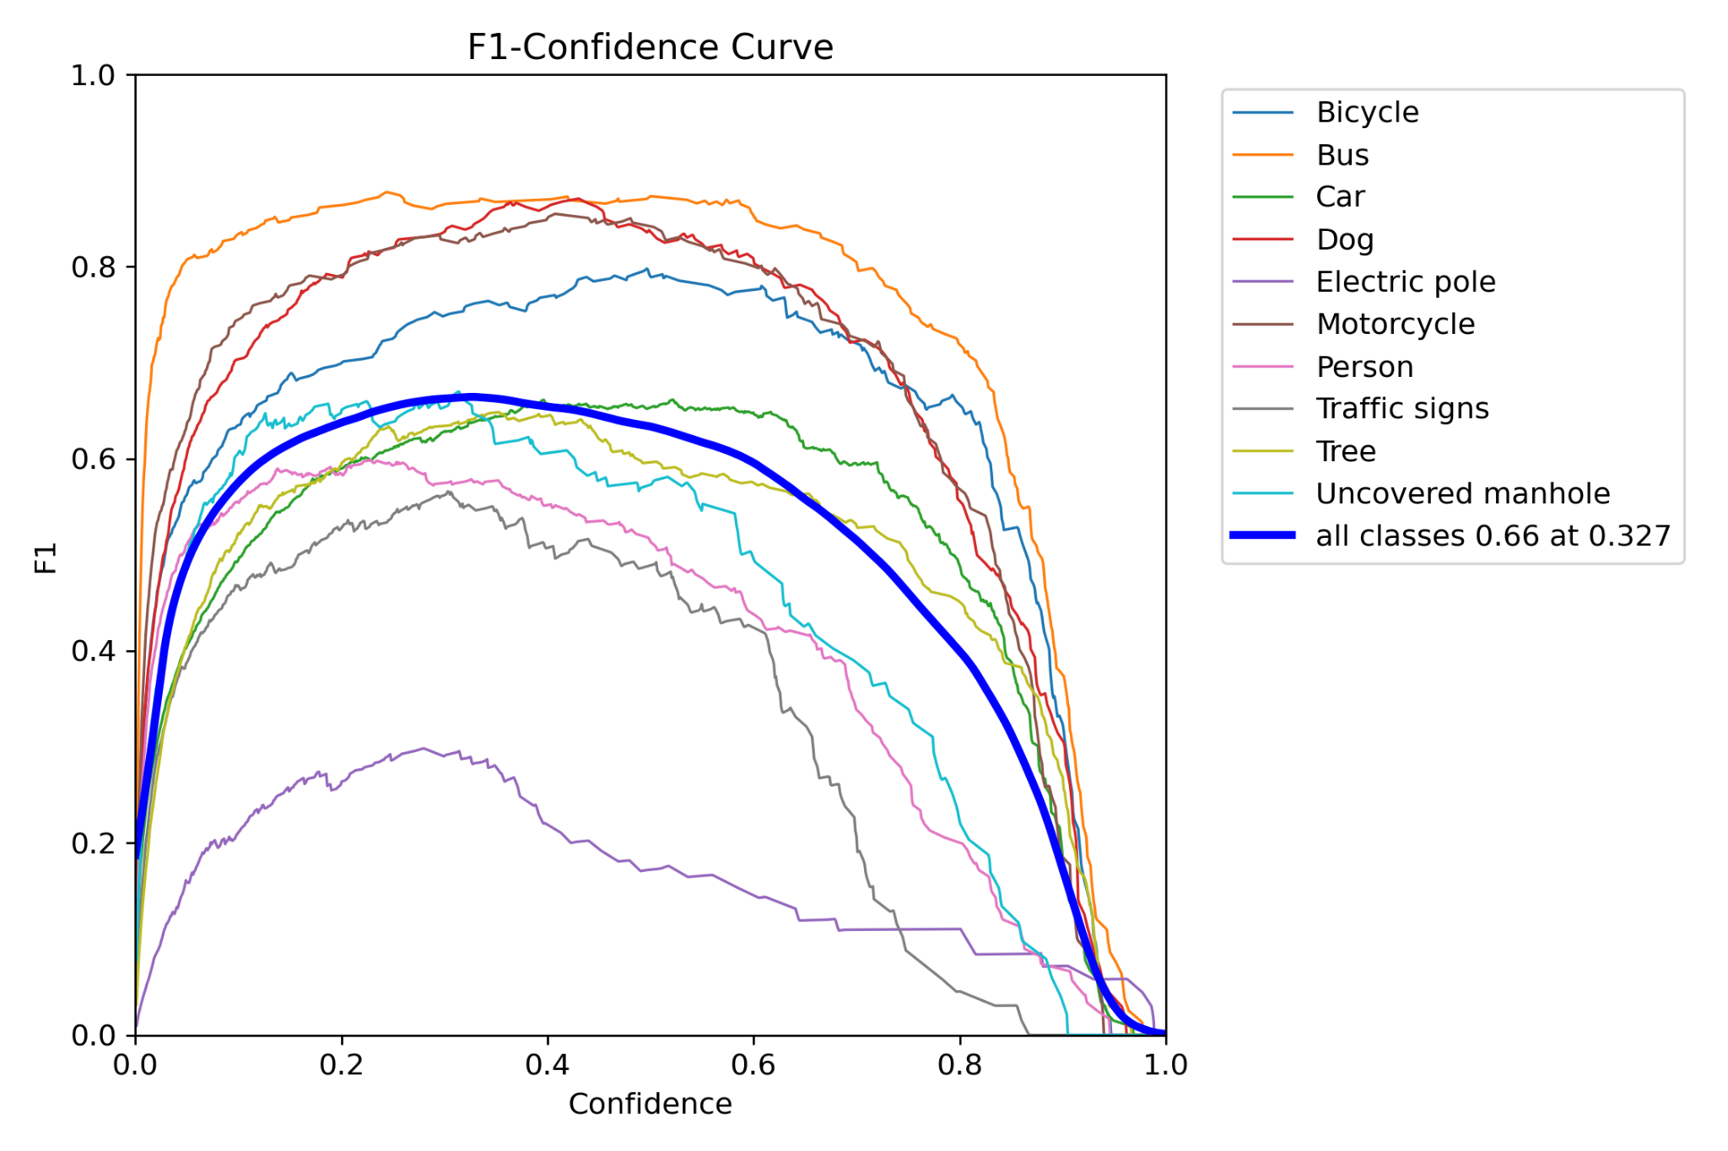
F1 curve

Slide 21
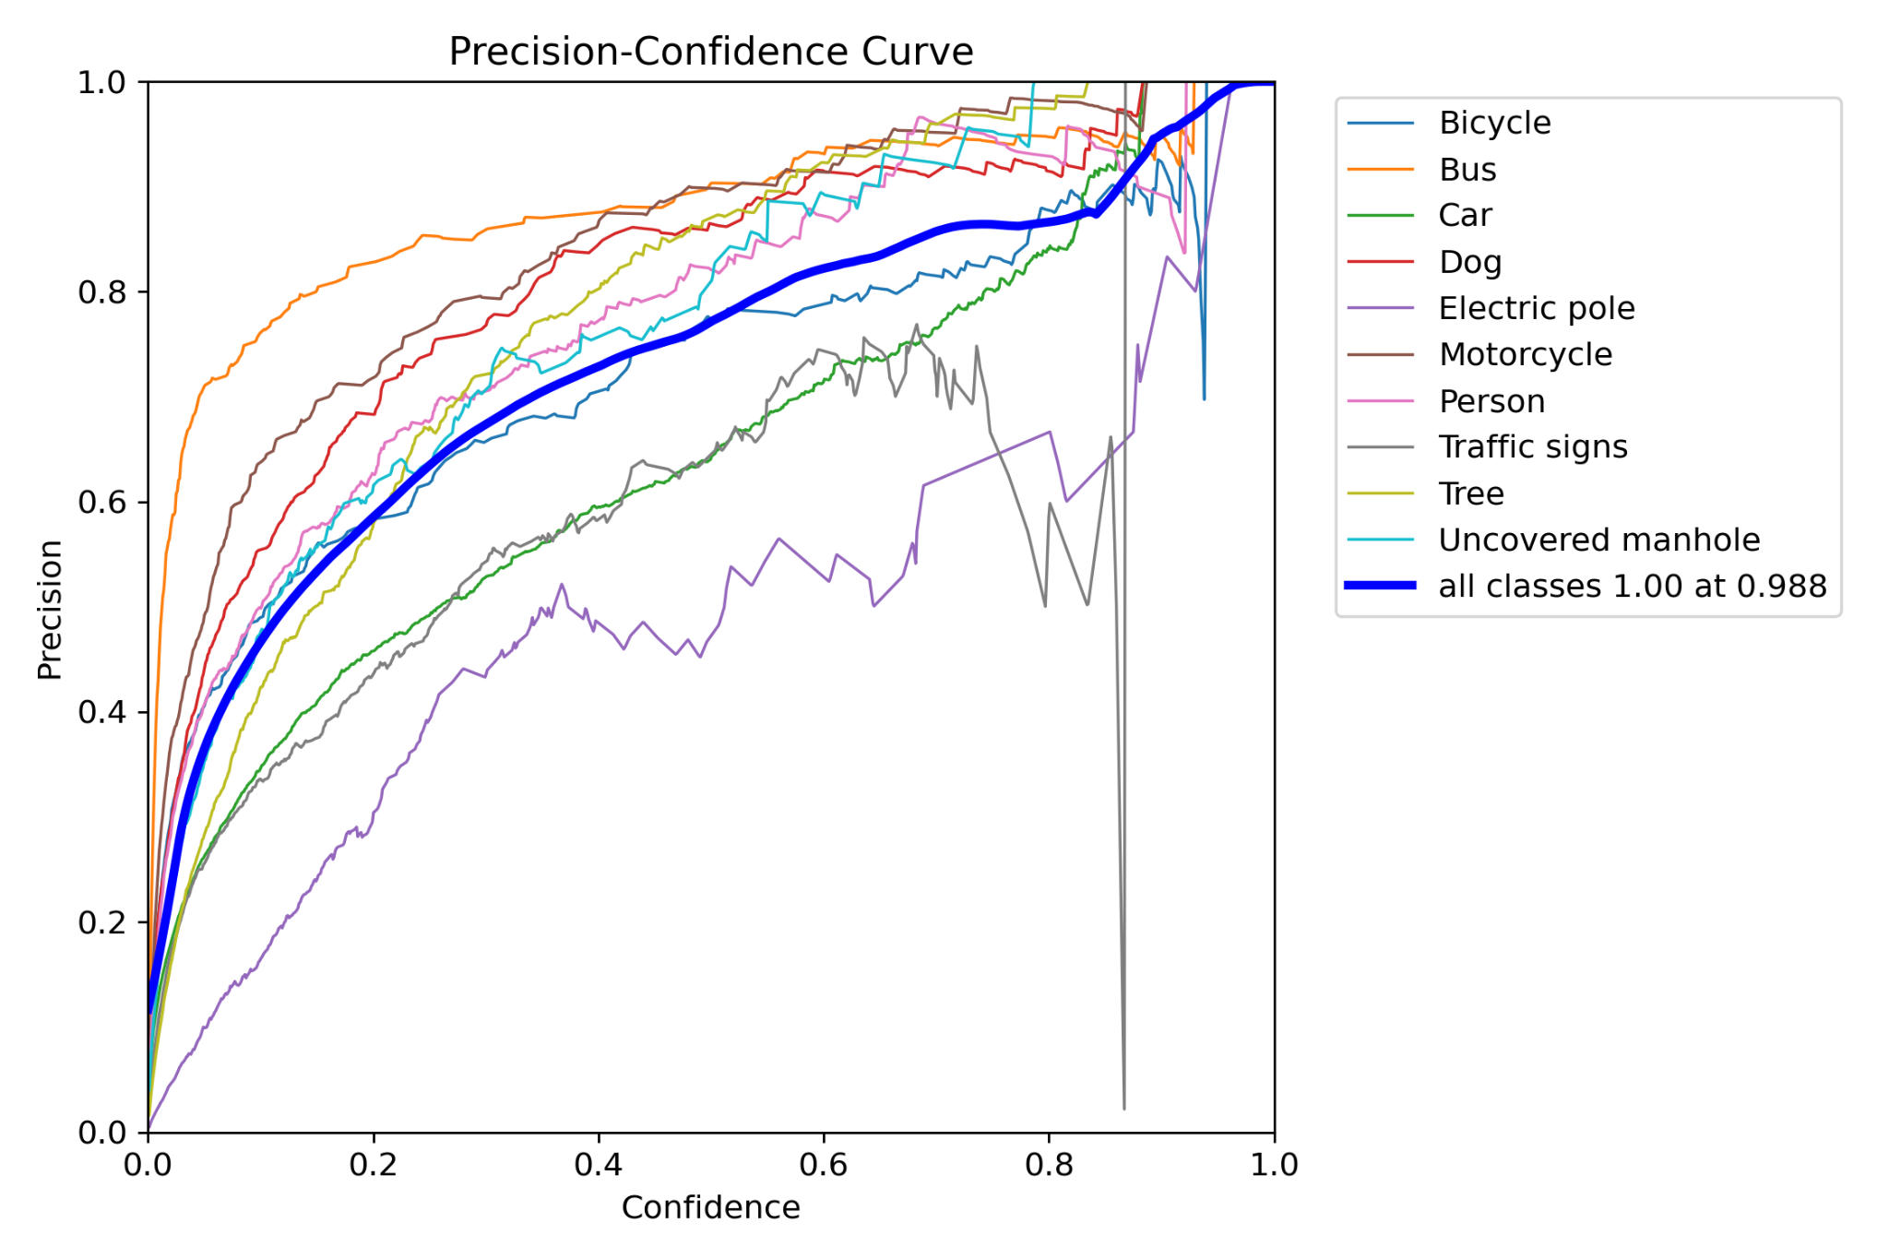
Precision confidence curve

Slide 22
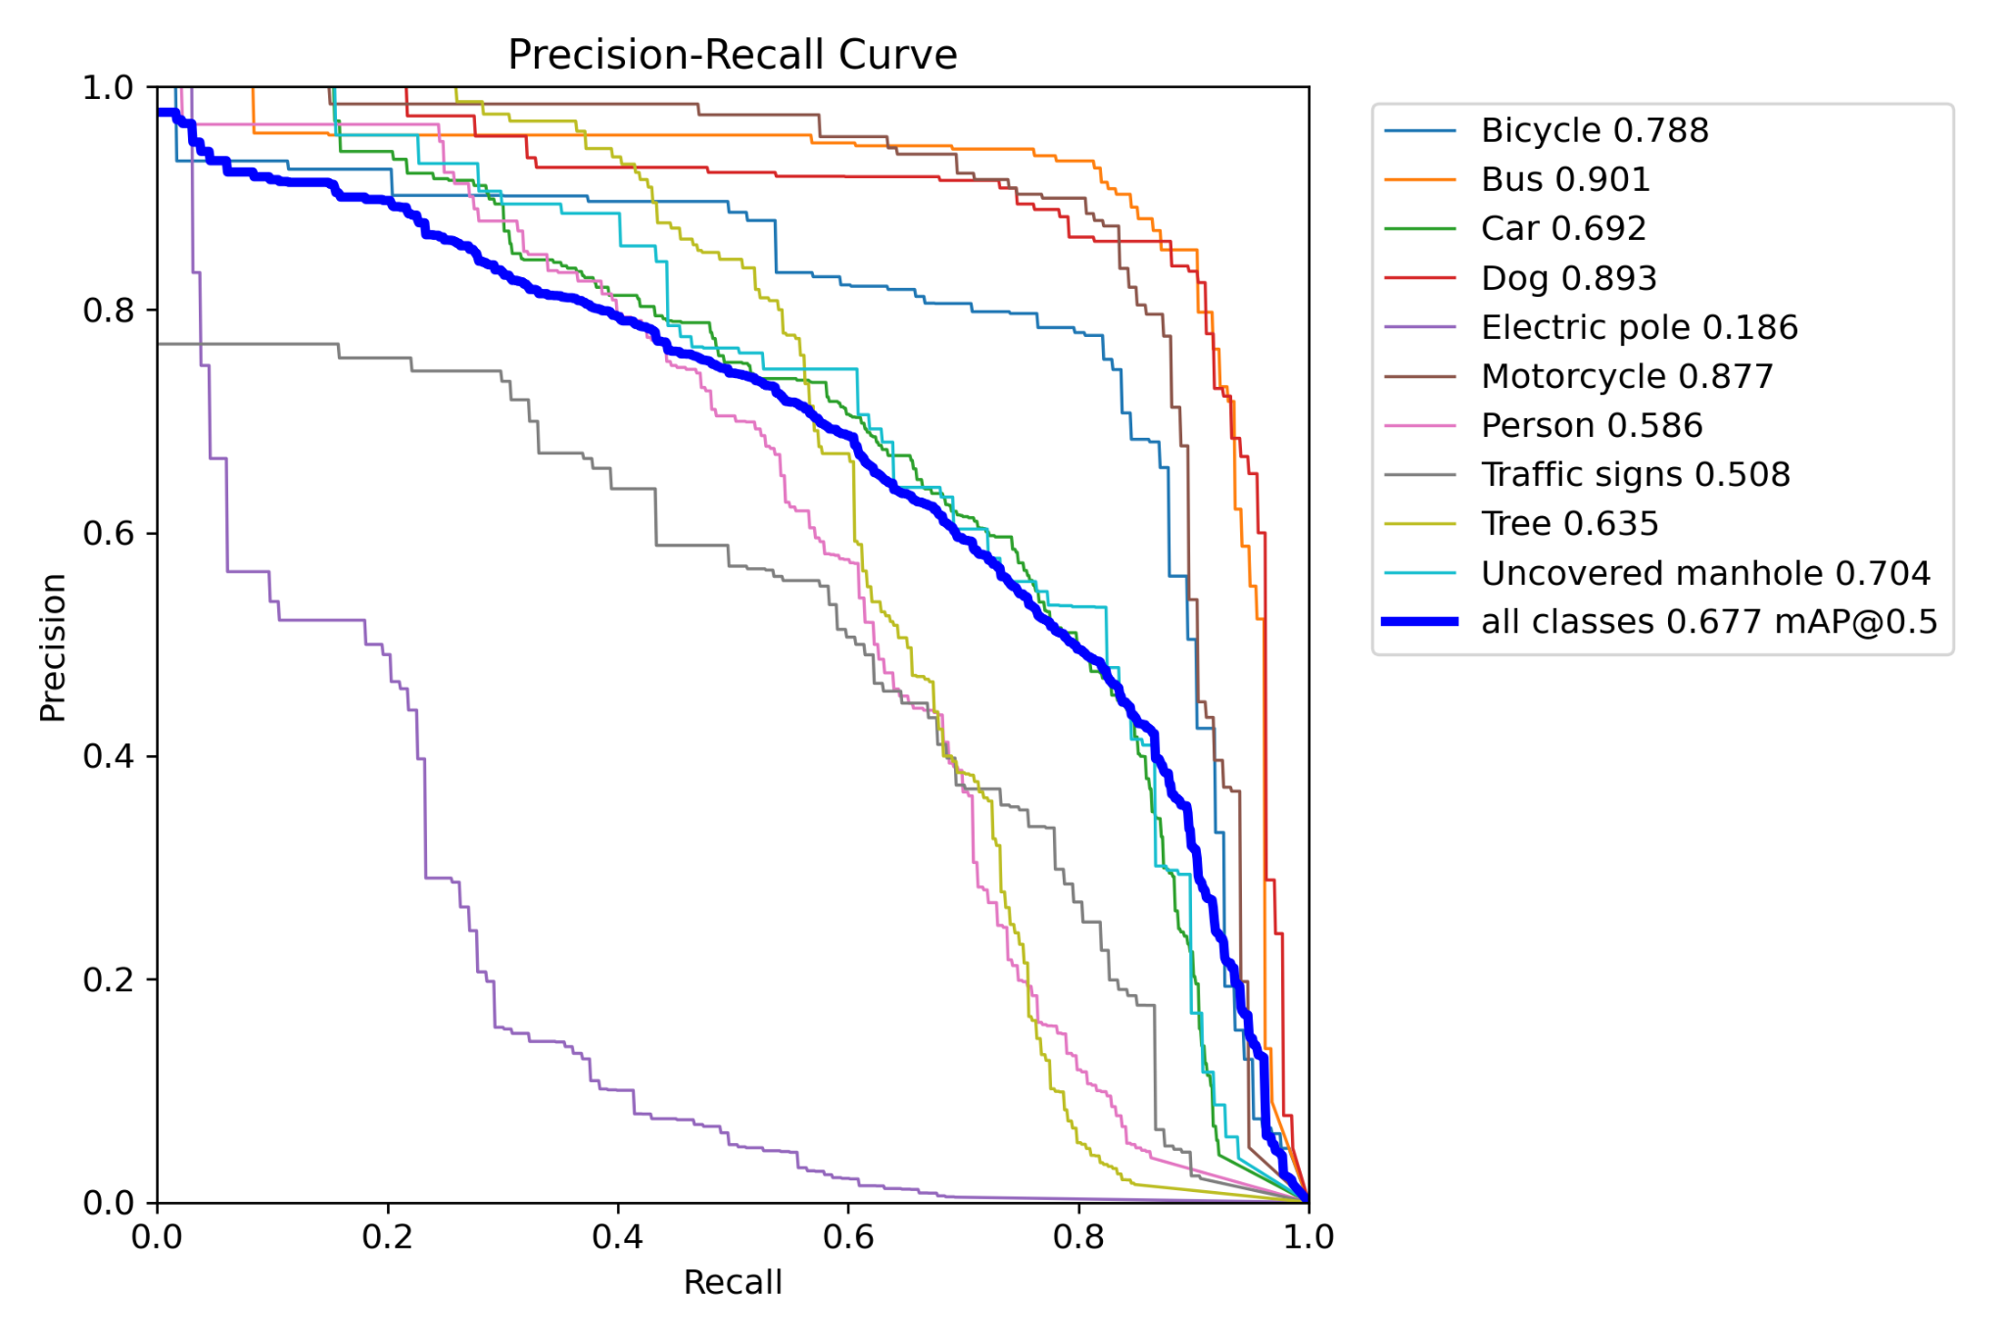
Precision recall curve

Slide 23
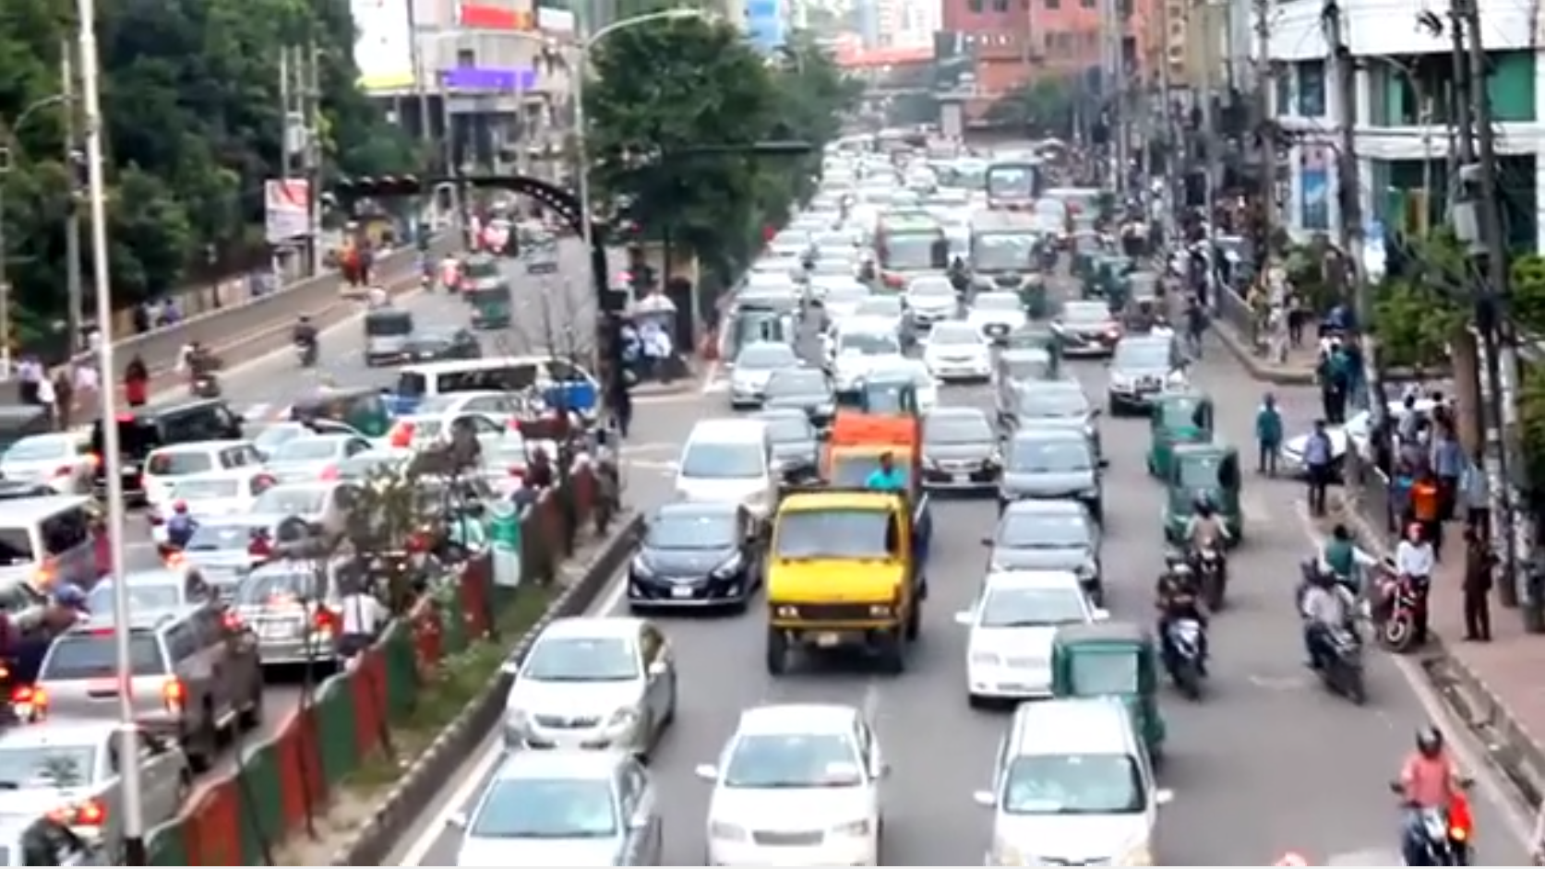
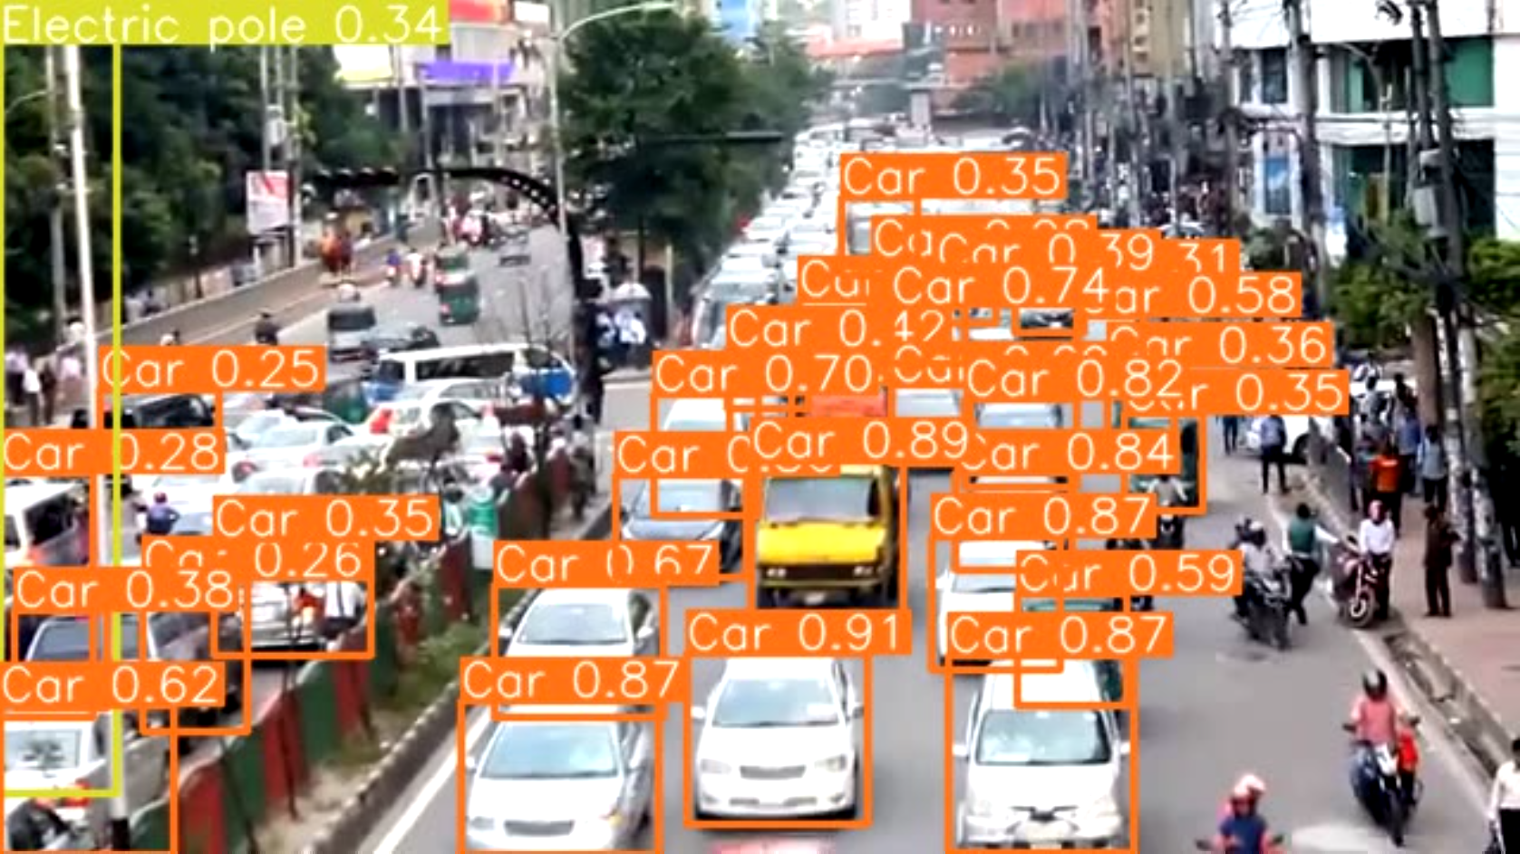
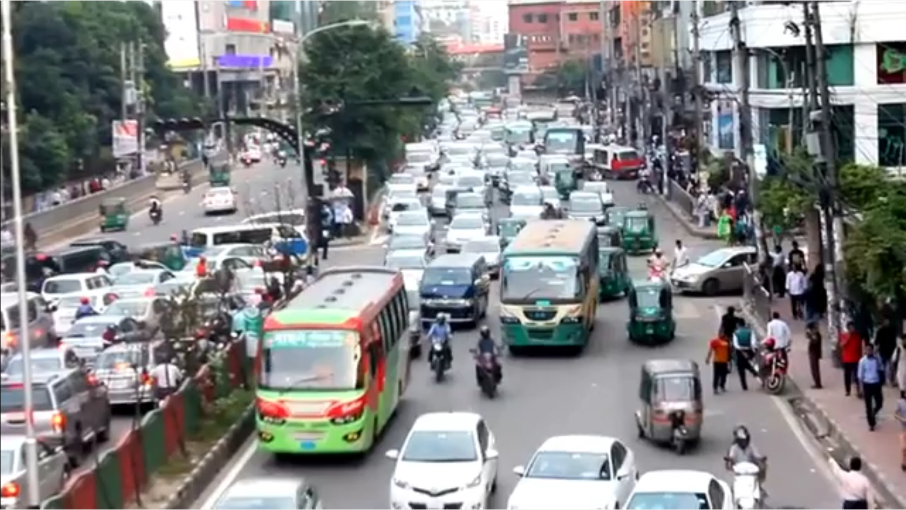
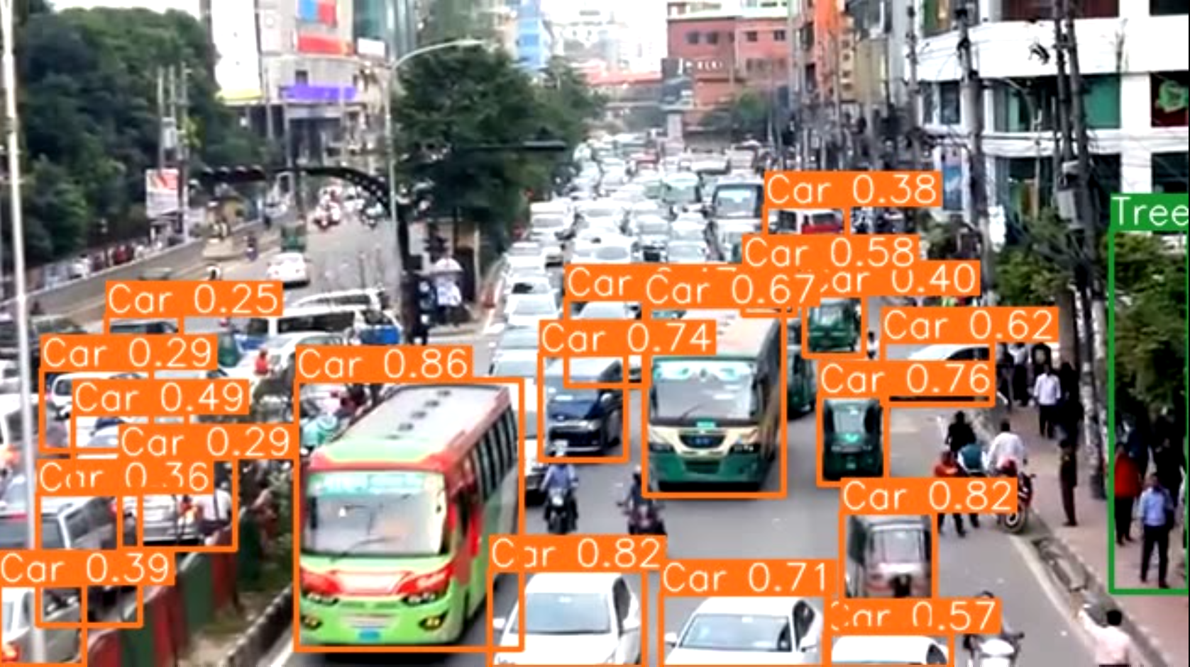
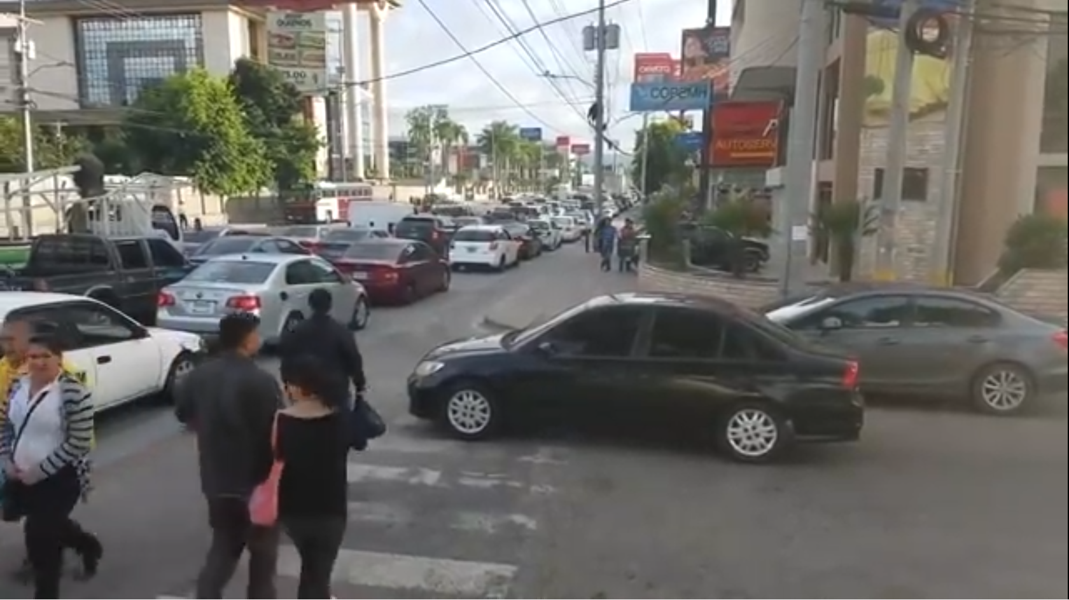
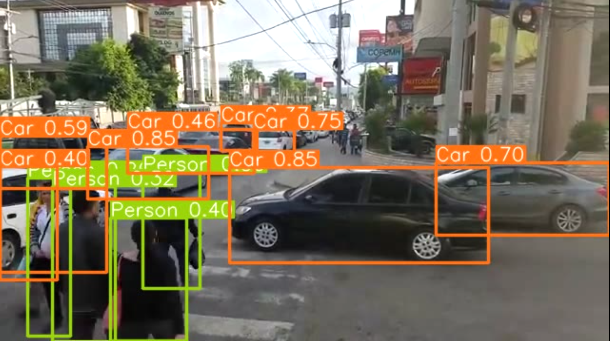
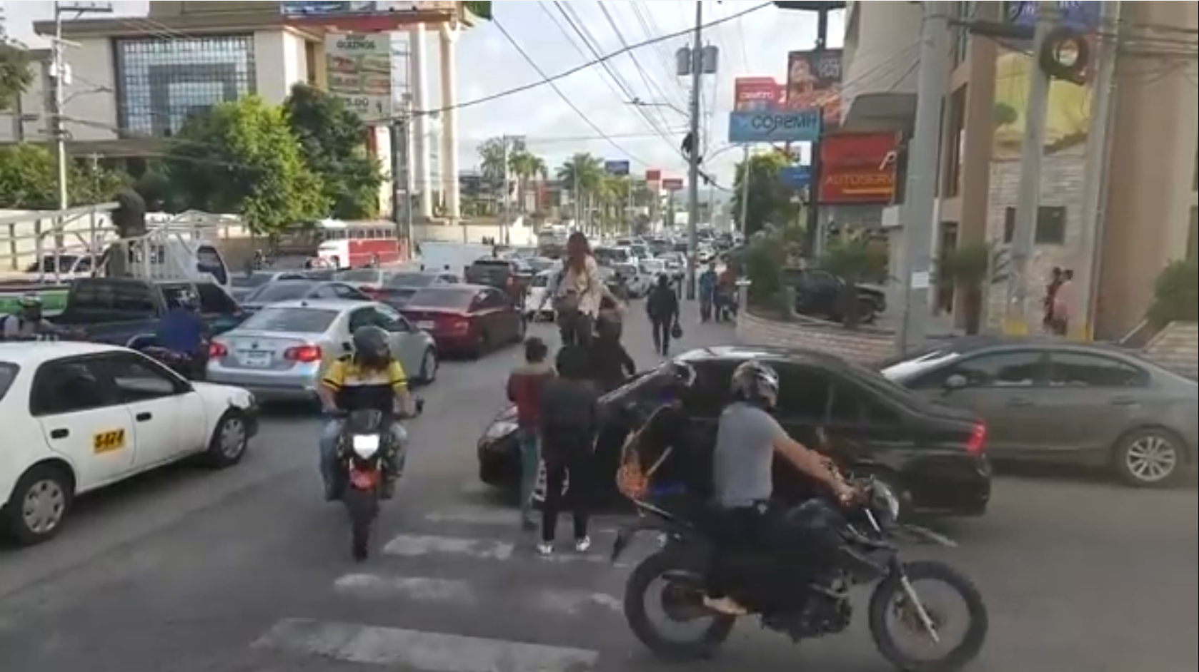
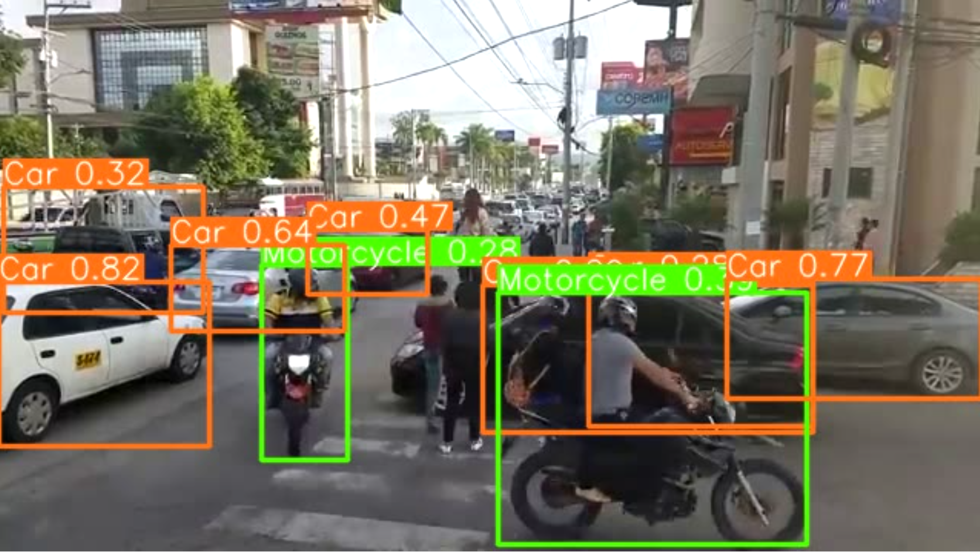
Detection Outcome

Slide 24
Conclusion
The model maintains high accuracy and speed for nuScenes, roboflow dataset. In future we would like to extend our work for different dataset and changing the parameters for more reliability and accuracy.

Slide 25
Thank You

